Slide 1
JAVA GUI Event Handling

Slide 2
What is an Event?
GUI components communicate with the rest of the applications through events.
The source of an event is the component that causes that event to occur.
The listener of an event is an object that receives the event and processes it appropriately.

Slide 3
Handling Events
Every time the user types a character or clicks the mouse, an event occurs.
Any object can be notified of any particular event.
To be notified for an event,
  The object has to be registered as an event listener on the appropriate event source.
  The object has to implement the appropriate interface.

Slide 4
Event Handling Model of AWT
Event object
Event handling
methods
Event source
Event listener

Slide 5
Action Events on Buttons
ActionEvent
actionPerformed(..)
Button
ActionListener

Slide 6
How to Attach an Event Listener to an Event Source
o is an event source
h is an event listener of type XXX
o.addXXX(h)
where XXX is one of the following:
  ActionListener
  MouseListener
  MouseMotionListener
  KeyListener
  WindowListener
  ComponentListener
  FocusListener
  TextListener
  AdjustmentListener
  ItemListener

Slide 7
The ActionListener Interface
interface ActionListener {
public void actionPerformed(ActionEvent e);
}
Possible event sources
  Button
  List
  TextField
  MenuItem

Slide 8
Example
Hello World (version 1)
import java.awt.*;
import java.awt.event.*;
public class TestButtonAction {
public static void main(String[] args){
Frame f = new Frame("TestButton");
f.setSize(200,200);
Button hw = new Button("Hello World!");
f.add(hw);
hw.addActionListener(new ActionListener(){
public void actionPerformed(ActionEvent e){
System.exit(0);
}
});
f.setVisible(true);
}
}

Slide 9
Example
Hello World (version 2)
class MyFrame extends Frame implements ActionListener {
Button hw;
public MyFrame(){
super("Test Button");
setSize(200,200);
hw = new Button("Hello World!");
add(hw);
hw.addActionListener(this);
show();
}
public void actionPerformed(ActionEvent o){
System.exit(0);
}
}

Slide 10
Example
Hello World (version 3)
class MyFrame extends Frame {
Button hw;
public MyFrame(){
super("Test Button");
setSize(200,200);
hw = new Button("Hello World!");
add(hw);
hw.addActionListener(new MyActionListener());
show();
class MyActionListener implements ActionListener {
public void actionPerformed(ActionEvent o){
System.exit(0);
}
}
}
}

Slide 11
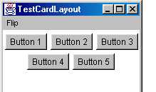
Revisit CardLayout
Flip Cards
MenuItem bp = new MenuItem("Flip to Button Panel");
bp.addActionListener(new ActionListener(){
public void actionPerformed(ActionEvent e){
CardLayout layout = (CardLayout)f.getLayout();
layout.show(f,"ButtonPanel");
}
});

Slide 12
How to Use FileDialog?
Menu m1 = new Menu("File");
MenuItem open = new MenuItem("Open"); m1.add(open);
mb.add(m1);
final TextArea ta = new TextArea(10,10);
f.add(ta);
open.addActionListener(new ActionListener(){
public void actionPerformed(ActionEvent e){
FileDialog dialog = new FileDialog(f, "Open File", FileDialog.LOAD);
dialog.show();
ta.append(dialog.getFile()+"\n");
}
});

Slide 13
MouseListener
mouseClicked(MouseEvent)
  Invoked when the mouse has been clicked on a component.
mouseEntered(MouseEvent)
  Invoked when the mouse enters a component.
mouseExited(MouseEvent)
  Invoked when the mouse exits a component.
mousePressed(MouseEvent)
  Invoked when a mouse button has been pressed on a component.
mouseReleased(MouseEvent)
  Invoked when a mouse button has been released on a component.

Slide 14
MouseAdapter
class MouseAdapter implements MouseListener {
public void mouseClicked(MouseEvent e){}
public void mouseEntered(MouseEvent e){}
public void mouseExited(MouseEvent e){}
public void mousePressed(MouseEvent e){}
public void mouseReleased(MouseEvent e){}
}

Slide 15
Example
import java.applet.*;
import java.awt.*;
import java.awt.event.*;
public class TestMouseListener {
public static void main(String[] args){
Frame f = new Frame("TestMouseListener");
f.setSize(500,500);
f.addMouseListener(new MouseAdapter(){
public void mouseClicked(MouseEvent e){
System.out.println("Mouse clicked: ("+e.getX()+","+e.getY()+")");
}
....
}

Slide 16
MouseMotionListener
mouseDragged(MouseEvent)
  Invoked when a mouse button is pressed on a component and then dragged.

Slide 17
An example of Event Handling
public class SwingApplication implements ActionListener {
...
JButton button = new JButton("I'm a Swing button!");
button.addActionListener(this);
....
public void actionPerformed(ActionEvent e) { numClicks++;
label.setText(labelPrefix + numClicks);
}
}

Slide 18
The Event Handling process
When an event is triggered, the JAVA runtime first determines its source and type.
If a listener for this type of event is registered with the source, an event object is created.
For each listener to this type of an event, the JAVA runtime invokes the appropriate event handling method to the listener and passes the event object as the parameter.

Slide 19
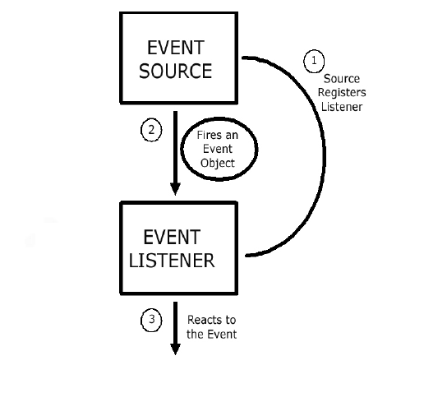
The Event Handling Process
(contd..)

Slide 20
What does an Event Handler require?
It just looks for 3 pieces of code!
First, in the declaration of the event handler class, one line of code must specify that the class implements either a listener interface or extends a class that implements a listener interface.
public class DemoClass implements ActionListener {

Slide 21
What does an Event Handler require? (contd..)
Second, it looks for a line of code which registers an instance of the event handler class as a listener of one or more components because, as mentioned earlier, the object must be registered as an event listener.
anyComponent.addActionListener(instanceOf DemoClass);

Slide 22
What does an Event Handler require? (contd..)
Third, the event handler must have a piece of code that implements the methods in the listener interface.
public void actionPerformed(ActionEvent e) {
...//code that reacts to the action...
}

Slide 23
Types of Events
Below, are some of the many kinds of events, swing components generate.
Act causing Event | Listener Type
User clicks a button, presses Enter, typing in text field | ActionListener
User closes a frame | WindowListener
Clicking a mouse button, while the cursor is over a component | MouseListener

Slide 24
Types of Events (contd..)
Act causing Event | Listener Type
User moving the mouse over a component | MouseMotionListener
Component becomes visible | ComponentListener
Table or list selection changes | ListSelectionListener

Slide 25
The Event classes
An event object has an event class as its reference data type.
The Event object class
  Defined in the java.util package.
The AWT Event class
  An immediate subclass of EventObject.
  Defined in java.awt package.
  Root of all AWT based events.

Slide 26
Event Listeners
Event listeners are the classes that implement the
<type>Listener interfaces.
Example:
1. ActionListener receives action events
2. MouseListener receives mouse events.
The following slides give you a brief overview on some of the listener types.

Slide 27
The ActionListener Method
It contains exactly one method.
Example:
public void actionPerformed(ActionEvent e)
The above code contains the handler for the ActionEvent e that occurred.

Slide 28
The MouseListener Methods
Event handling when the mouse is clicked.
public void mouseClicked(MouseEvent e)
Event handling when the mouse enters a component.
public void mouseEntered(MouseEvent e)
Event handling when the mouse exits a component.
public void mouseExited(MouseEvent e)

Slide 29
The MouseListener Methods (contd..)
Event handling when the mouse button is pressed on a component.
public void mousePressed(MouseEvent e)
Event handling when the mouse button is released on a component.
public void mouseReleased(MouseEvent e)

Slide 30
The MouseMotionListener Methods
Invoked when the mouse button is pressed over a component and dragged. Called several times as the mouse is dragged
public void mouseDragged(MouseEvent e)
Invoked when the mouse cursor has been moved onto a component but no buttons have been pushed.
public void mouseMoved(MouseEvent e)

Slide 31
The WindowListener Methods
Invoked when the window object is opened.
public void windowOpened(WindowEvent e)
Invoked when the user attempts to close the window object from the object’s system menu.
public void windowClosing(WindowEvent e)

Slide 32
The WindowListener Methods (contd..)
Invoked when the window object is closed as a result of calling dispose (release of resources used by the source).
public void windowClosed(WindowEvent e)
Invoked when the window is set to be the active window.
public void windowActivated(WindowEvent e)

Slide 33
The WindowListener Methods (contd..)
Invoked when the window object is no longer the active window
public void windowDeactivated(WindowEvent e)
Invoked when the window is minimized.
public void windowIconified(WindowEvent e)
Invoked when the window is changed from the minimized state to the normal state.
public void windowDeconified(WindowEvent e)

Slide 34
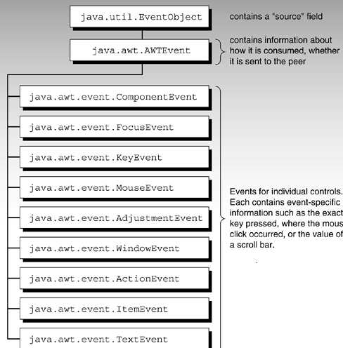
Hierarchy of event objects
Note: The number of event objects is much greater then specified in diagram…Due to space constraints, only some of them are represented in the figure
Courtesy: Safari.oreilly.com

Slide 35
Additional Listener Types
Item Listener
Key Listener
Property Change Listener
Table Model Listener
Change Listener
Container Listener
Document Listener
Focus Listener
Internal Frame Listener
The main purpose of the last few slides is to give you an idea as to how you can use event handlers in your programs. It is beyond the scope of the O’Reilly book to cover every event handler. See the JAVA tutorials for more information.

Slide 36
Adapter classes for Event Handling.
Why do you need adapter classes?
  Implementing all the methods of an interface involves a lot of work.
  If you are interested in only using some methods of the interface.
Adapter classes
  Built-in in JAVA
  Implement all the methods of each listener interface with more than one method.
  Implementation of all empty methods

Slide 37
Adapter classes - an Illustration.
Consider, you create a class that implements a MouseListener interface, where you require only a couple of methods to be implemented. If your class directly implements the MouseListener, you must implement all five methods of this interface.
Methods for those events you don't care about can have empty bodies

Slide 38
Illustration (contd..)
public class MyClass implements MouseListener {
... someObject.addMouseListener(this);
/* Empty method definition. */
public void mousePressed(MouseEvent e) { }
/* Empty method definition. */
public void mouseReleased(MouseEvent e) { }
/* Empty method definition. */
public void mouseEntered(MouseEvent e) { }
/* Empty method definition. */
public void mouseExited(MouseEvent e) { }
public void mouseClicked(MouseEvent e) {
//Event listener implementation goes here...
}
}

Slide 39
Illustration (contd..)
What is the result?
  The resulting collection of empty bodies can make the code harder to read and maintain.
To help you avoid implementing empty bodies, the API generally includes an adapter class for each listener interface with more than one method. For example, the MouseAdapter class implements the MouseListener interface.

Slide 40
How to use an Adapter class?
/* Using an adapter class
*/
public class MyClass extends MouseAdapter {
....
someObject.addMouseListener(this);
....
public void mouseClicked(MouseEvent e) {
...//Event listener implementation goes
// here
}
}

Slide 41
Using Inner classes for Event Handling
Consider that you want to use an adapter class but you don’t want your public class to inherit from the adapter class.
For example, you write an applet with some code to handle mouse events. As you know, JAVA does not permit multiple inheritance and hence your class cannot extend both the Applet and MouseAdapter classes.

Slide 42
Using Inner classes (contd..)
Use a class inside your Applet subclass that extends the MouseAdapter class.
public class MyClass extends Applet { ...
someObject.addMouseListener(new MyAdapter());
...
class MyAdapter extends MouseAdapter { public void mouseClicked(MouseEvent e) {
//Event listener implementation here... }
}
}

Slide 43
Creating GUI applications with Event Handling.
Guidelines:
  Create a GUI class
    Describes the appearance of your GUI application.
  Create a class implementing the appropriate listener interface
    May refer to the same class as step 1.

Slide 44
Creating GUI applications with Event Handling (contd..)
  In the implementing class
    Override all methods of the appropriate listener interface.
    Describe in each method how you want to handle the events.
    May give empty implementations for the methods you don’t need.

Slide 45
Creating GUI applications with Event Handling (contd..)
  Register the listener object with the source
    The object is an instantiation of the listener class specified in step 2.
    Use the add<Type>Listener method.

Slide 46
Design Considerations
The most important rule to keep in mind about event listeners is that they must execute quickly. Because, all drawing and event-listening methods are executed in the same thread, a slow event listener might make the program seem unresponsive. So, consider the performance issues also when you create event handlers in your programs.

Slide 47
Design Considerations
You can have choices on how the event listener has to be implemented. Because, one particular solution might not fit in all situations.
For example, you might choose to implement separate classes for different types of listeners. This might be a relatively easy architecture to maintain, but many classes can also result in reduced performance .

Slide 48
Common Event-Handling Issues
You are trying to handle certain events from a component, but it doesn’t generate the events it should.
  Make sure you have registered the right kind of listener to detect the events.
  Make sure you have registered the listener on the right object.
  Make sure you have implemented the event handler correctly, especially, the method signatures.

Slide 49
Common Event-Handling Issues (contd..)
Your combo box isn’t generating low level events like focus events.
  Since combo boxes are compound components, i.e., components implemented using multiple components, combo-boxes do not fire the low-level events that simple components fire.

Slide 50
Common Event-Handling Issues (contd..)
The document for an editor pane is not triggering document events.
  The document instance for an editor pane might change when loading text from a URL. Thus your listeners might be listening for events on an unused document.
  Hence, make sure that the code adjusts for possible changes to the document if your program dynamically loads text into an editor pane.

